Slide 1
Transport Layer Protocols
Dr Sujit Das

Slide 2
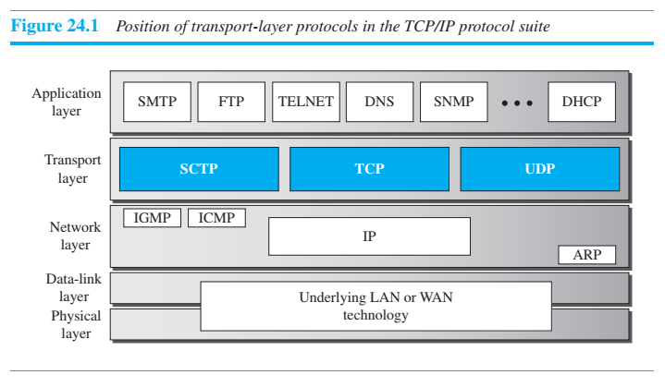
Transport Layer Protocols

Slide 3
Services
UDP
UDP is an unreliable connectionless transport-layer protocol used for its simplicity and efficiency in applications where error control can be provided by the application-layer process.
TCP
TCP is a reliable connection-oriented protocol that can be used in any application where reliability is important.
SCTP
SCTP is a new transport-layer protocol that combines the features of UDP and TCP.

Slide 4
USER DATAGRAM PROTOCOL
The User Datagram Protocol (UDP) is a connectionless, unreliable transport protocol.
It does not add anything to the services of IP except for providing process-to-process communication instead of host-to-host communication.
If UDP is so powerless, why would a process want to use it?
With the disadvantages come some advantages. UDP is a very simple protocol using a minimum of overhead.
If a process wants to send a small message and does not care much about reliability, it can use UDP.
Sending a small message using UDP takes much less interaction between the sender and receiver than using TCP.

Slide 5
User Datagram
UDP packets, called user datagrams, have a fixed-size header of 8 bytes made of four fields, each of 2 bytes (16 bits).
Figure 24.2 shows the format of a user datagram. The first two fields define the source and destination port numbers.
The third field defines the total length of the user datagram, header plus data.
The 16 bits can define a total length of 0 to 65,535 bytes. However, the total length needs to be less because a UDP user datagram is stored in an IP datagram with the total length of 65,535 bytes.
The last field can carry the optional checksum (explained later)

Slide 6
UDP Services
Process-to-Process Communication
UDP provides process-to-process communication using socket addresses, a combination of IP addresses and port numbers.
Connectionless Services
As mentioned previously, UDP provides a connectionless service. This means that each user datagram sent by UDP is an independent datagram.
There is no relationship between the different user datagrams even if they are coming from the same source process and going to the same destination program.
The user datagrams are not numbered.
Also, unlike TCP, there is no connection establishment and no connection termination. This means that each user datagram can travel on a different path.
Flow Control
UDP is a very simple protocol. There is no flow control, and hence no window mechanism.
The receiver may overflow with incoming messages. The lack of flow control means that the process using UDP should provide for this service, if needed.

Slide 7
UDP Services
Error Control There is no error control mechanism in UDP except for the checksum.
This means that the sender does not know if a message has been lost or duplicated.
When the receiver detects an error through the checksum, the user datagram is silently discarded.
The lack of error control means that the process using UDP should provide for this service, if needed

Slide 8
TRANSMISSION CONTROL PROTOCOL
Transmission Control Protocol (TCP) is a connection-oriented, reliable protocol.
TCP explicitly defines connection establishment, data transfer, and connection teardown phases to provide a connection-oriented service.
TCP uses a combination of GBN and SR protocols to provide reliability.
To achieve this goal, TCP uses checksum (for error detection), retransmission of lost or corrupted packets, cumulative and selective acknowledgments, and timers.
TCP is the most common transport-layer protocol in the Internet.

Slide 9
TCP Services
Process-to-Process Communication
As with UDP, TCP provides process-to-process communication using port numbers.
Stream Delivery Service
TCP, on the other hand, allows the sending process to deliver data as a stream of bytes and allows the receiving process to obtain data as a stream of bytes.
TCP creates an environment in which the two processes seem to be connected by an imaginary “tube” that carries their bytes across the Internet.
Sending and Receiving Buffers
Because the sending and the receiving processes may not necessarily write or read data at the same rate, TCP needs buffers for storage.
There are two buffers, the sending buffer and the receiving buffer, one for each direction. These buffers are also necessary for flow- and error-control mechanisms used by TCP.
One way to implement a buffer is to use a circular array of 1-byte locations as shown in Figure 24.5.
For simplicity, we have shown two buffers of 20 bytes each; normally the buffers are hundreds or thousands of bytes, depending on the implementation.
We also show the buffers as the same size, which is not always the case

Slide 10
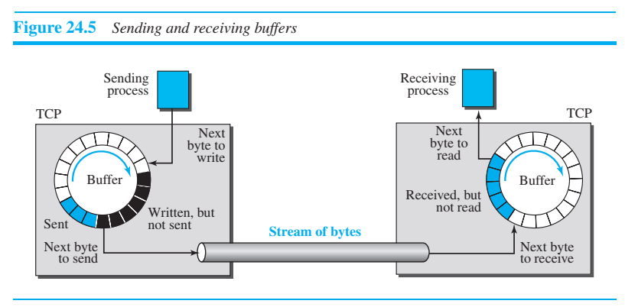
Sending and receiving buffer

Slide 11
Sending and Receiving Buffers
The figure shows the movement of the data in one direction. At the sender, the buffer has three types of chambers.
The white section contains empty chambers that can be filled by the sending process (producer).
The colored area holds bytes that have been sent but not yet acknowledged. The TCP sender keeps these bytes in the buffer until it receives an acknowledgment.
The shaded area contains bytes to be sent by the sending TCP.
However, as we will see later in this chapter, TCP may be able to send only part of this shaded section.
This could be due to the slowness of the receiving process or to congestion in the network.
Also note that, after the bytes in the colored chambers are acknowledged, the chambers are recycled and available for use by the sending process. This is why we show a circular buffer.

Slide 12
Sending and Receiving Buffers
The operation of the buffer at the receiver is simpler.
The circular buffer is divided into two areas (shown as white and colored).
The white area contains empty chambers to be filled by bytes received from the network.
The colored sections contain received bytes that can be read by the receiving process.
When a byte is read by the receiving process, the chamber is recycled and added to the pool of empty chambers.

Slide 13
Connection-Oriented Service
TCP, unlike UDP, is a connection-oriented protocol.
When a process at site A wants to send to and receive data from another process at site B, the following three phases occur:
The two TCP’s establish a logical connection between them.
Data are exchanged in both directions.
The connection is terminated.
Note that this is a logical connection, not a physical connection.
The TCP segment is encapsulated in an IP datagram and can be sent out of order, or lost or corrupted, and then resent.
Each may be routed over a different path to reach the destination. There is no physical connection.
TCP creates a stream-oriented environment in which it accepts the responsibility of delivering the bytes in order to the other site.

Slide 14
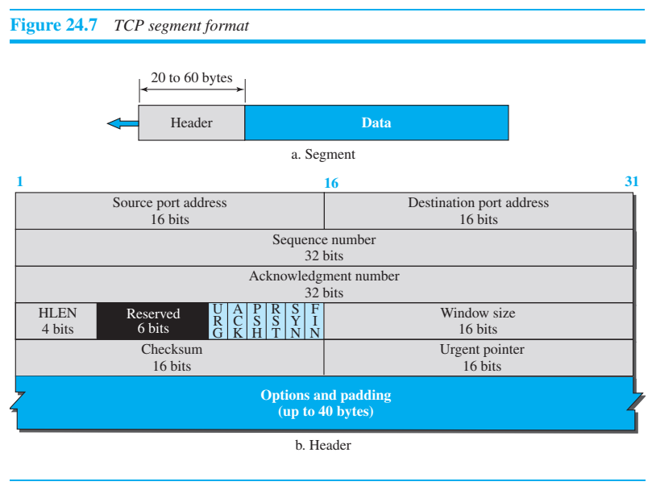
Segment A packet in TCP is called a segment

Slide 15
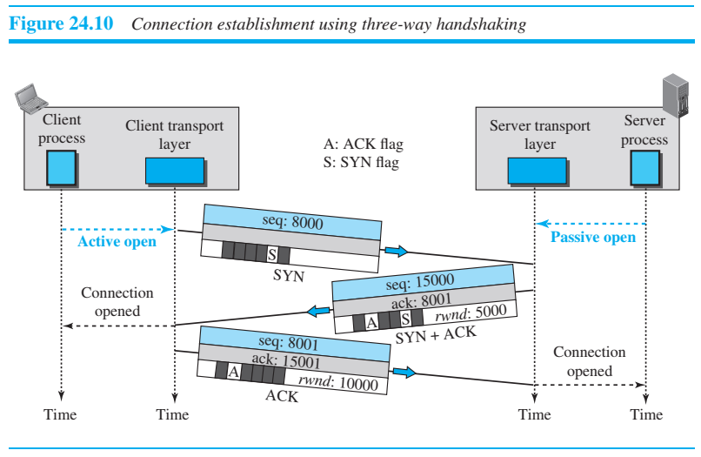
A TCP Connection
In TCP, connection-oriented transmission requires three phases: connection establishment, data transfer, and connection termination.

Slide 16
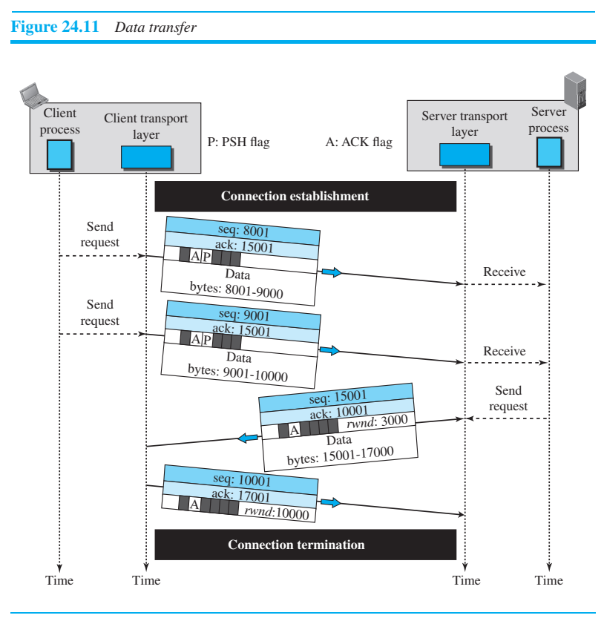

Slide 17
